Slide 1

Unix Operating Systems
School of Computer Engineering and technology

Slide 2

Unit 5- Unix Operating Systems
Introduction to Unix Operating System.
The Unix File System and Process Management.
Comparison between Windows OS, Unix and Linux.
Basics of shell scripting.
21/02/19
Operating system
2
Notes:
2
MIT-WPU

Slide 3
Reference book
The Design of the UNIX Operating System
by Maurice J. Bach
21/02/19
Operating system
3
Notes:
3
MIT-WPU

Slide 4
What is UNIX?
An Operating System (OS)
Mostly coded in C
Machine independence
It provides a number of facilities:
management of hardware resources
directory and file system
loading / execution / suspension of programs

Slide 5
History (Brief)
Unix is a multitasking, multi-user computer operating system
System originally developed in 1969 by AT & T employees at Bell Labs….
Key contributers :- Ken Thompson,Dennis Ritchie,Brian Kernighan

Slide 6
Why Use UNIX?
multi-tasking / multi-user
lots of software
networking capability
graphical (with command line)
easy to program
portable (PCs, mainframes, super-computers)
continued

Slide 7
Flavours/examples of Linux
Some Flavours of Unix ie Unix like systems
AIX by IBM
BSD/OS
HP-UX
Solaris

Slide 8
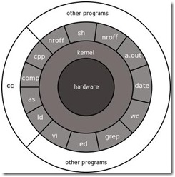
Architecture of Unix system
Kernel − The kernel interacts with the hardware and performs the tasks like memory management, task scheduling and file management. It is the heart of the OS.
Shell − The shell is the utility that processes your requests. It interprets the command and calls the program that you want.

Slide 9
Continued..
Commands and Utilities − There are various (250 standard) commands and utilities like cp, mv, cat and grep, etc.
Programs like shell and editors (ed and vi) interact with kernel by system calls(around 64).
Other application programs like CC can build on top of lower level programs.
Files and Directories − All the data of Unix is organized into files. All files are then organized into directories. These directories are further organized into a tree-like structure called the filesystem.

Slide 10
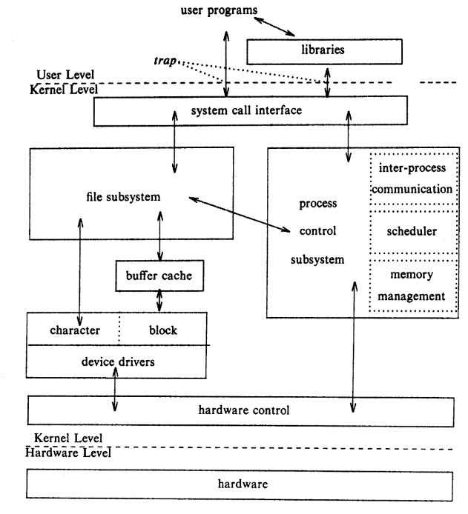
Block diagram of System Kernel
The two entities, files and processes, are the two central concepts in the UNIX system model.
There are three levels: user, kernel, and hardware.
The system call and library interface represent the border between user programs and the kernel
Libraries map the system calls to the primitives needed to enter OS
The file subsystem manages files, allocating file space, administering free space, controlling access to files, and retrieving data for users.

Slide 11
Continued..
Processes interact with the file subsystem via a specific set of system calls, such as open, close, read, write, stat (query the attributes of a file), chown (change the record of who owns the file), and chmod (change the access permissions of a file).
The process control subsystem is responsible for process synchronization, interprocess communication, memory management, and process scheduling
The hardware control is responsible for handling interrupts and for communicating with the machine.

Slide 12
UNIX file system
The UNIX file system is characterized by:
• A hierarchical structure,
• Consistent treatment of file data,
• The ability to create and delete files,
• Dynamic growth of files,
• The protection of file data,
• The treatment of peripheral devices (such as terminals and tape units) as files.

Slide 13
The File
Ordinary(Regular) Files
Directory Files
Device Files
The file system is organized as a tree with a single root node called “/”;
Every non-leaf node of the file system structure is directory of files, and files at the leaf nodes of the tree are either directories, files, or special device files.
The name of a file is given by the path name file in the file.

Slide 14
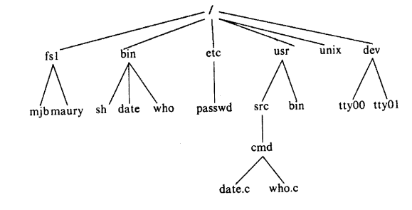
The Parent Child Relationship: simplified UNIX directory/file system

Slide 15
Some System Directories
/ root directory
/bin commands
/etc system data files (e.g. /etc/passwd)
/dev files representing I/O devices

Slide 16
Pathnames
A pathname is a sequence of directory names (separated by /’s) which identifies the location of a directory.
There are two sorts of pathnames
A full path or absolute path is a path that points to the same location on one file system regardless of the working directory or combined paths. It is usually written in reference to a root directory.
A relative path is a path relative to the working directory of the user or application, so the full absolute path will not have to be given.

Slide 17
Absolute Pathnames
Absolute Pathnames:The sequence of directory names between the top of the tree (the root) and the directory of interest.
For example:
/bin
/etc/terminfo
/export/user/home/ad
Relative Pathnames :The sequence of directory names below the directory where you are now to the directory of interest. For example:
If you are interested in the directory proj1:
proj1 if you are in s3910120
s3910120/proj1 if you are in home
home/s3910120/proj1 if you are in user

Slide 18
Access permissions
Permission to access a file is controlled by access perrnissions associated with the file.
Access permissions can be set independently to control read, write, an execute
permission for three classes of users: the file owner, a file group, an everyone else.
Users may create files if directory access permissions allow it.
The newly created files are leaf nodes of the file system directory structure.
ls –l /etc/passwd
-rw-r--r-- 1 root root 2365 Jul 28 16:19 /etc/passwd
read, write, execute (r w x)
- rw- r-- r--
directory owner group everyone
chmod

Slide 19
Standard Files
UNIX concept of “standard files”
standard input (where a command gets its input) –
standard output (where a command writes it output) -
standard error (where a command writes error messages)

Slide 20
Redirecting Output
The output of a command may be sent (piped) to a file:
The input of a command may come (be piped) from a file:
ls -l >output
wc <input
“>” is used to specify the output file
“<” is used to specify the input file

Slide 21
Connecting commands: Pipes
The output of one command can become the input of another:
Pipes, “|” is used to separate stages
ps aux | grep Linux | wc -l
wc takes this input and counts the lines its output going to the console
The output of the ps command is sent to grep
grep takes input and searches for “Linux” passing these lines to wc

Slide 22
Commands and Pathnames
Commands often use pathnames.
For example:
cat /etc/passwd List the password file

Slide 23
Moving between Directories
S3910120 is home directory:
If you are in directory s3910120 how do you move to directory proj1?
cd proj1
You are now in proj1: This is called the current working directory.
Pwd Print name of current working directory
Move back to directory s3910120 (the parent directory):
cd ..
When in proj1, move to proj2 with one command:
cd ../proj2 ../proj2 is a relative pathname
s3910120
proj1
proj2
hobby.c
. . .
. . .

Slide 24
Special Directory Names
/ The root directory
. The current working directory
.. The parent directory (of your current directory)
Examples:
cd / Change to root directory
cd ~ Change to home directory
cd (Special case; means cd ~)
cd ../.. Go up two levels.

Slide 25
Investigate the System
Use cd
cat file List file
cd /etc
cat passwd
ls Directory listing
ls List current dir.
ls /etc List /etc

Slide 26
Making / Deleting / Renaming Directories
Usually, you can only create directories (or delete or rename them) in your home directory or directories below it.
mkdir Make a directory
rmdir Delete a directory
mv Rename a directory

Slide 27
Commands to work with files
cat > filename
less
head
tail
cp
mv
rm
wc
grep

Slide 28
Information on Others
users Who else is logged on?
who Information on current users
ps What are people doing?

Slide 29
Mounting
Mounting a device makes it accessible by the computer. This is a software process that enables the operating system to read and write data to the device.
Unmounting a device is the opposite of mounting a device. It takes a mounted device and makes it inaccessible by the computer.
The file named /etc/fstab is used to define mountable file systems and devices on startup.

Slide 30
File System
A file system is consists of a sequence of logical blocks (512/1024 byte etc.)
A file system has the following structure:
Boot Block | Super Block | Inode List | Data Blocks

Slide 31
File System: Boot Block
The beginning of the file system
Contains bootstrap code to load the operating system
Initialize the operating system
Typically occupies the first sector of the disk
Super Block
Describes the state of a file system
Describes the size of the file system
How many files it can store
Where to find free space on the file system
Other information

Slide 32
File System:
Inode List
Inodes are used to access disk files.
Inodes maps the disk files
For each file there is an inode entry in the inode list block
Inode list also keeps track of directory structure
Data Block
Starts at the end of the inode list
Contains disk files
An allocated data block can belong to one and only one file in the file system

Slide 33
Processes
A process is the execution of a program
A process is consists of text (machine code), data and stack
Many process can run simultaneously as kernel schedules them for execution
Several processes may be instances of one program
A process reads and writes its data and stack sections, but it cannot read or write the data and stack of other processes
A process communicates with other processes and the rest of the world via system calls

Slide 34
Process Context
The context of a process is defined by code,data,stack and its execution environment.
Context Switch
When the kernel decides that it should execute another process, it does a context switch, so that the system executes in the context of the other process
When doing a context switch, the kernel saves enough information so that it can later switch back to the first process and resume its execution.

Slide 35
Mode of Process Execution
The UNIX process runs in two modes:
User mode
Can access its own instructions and data, but not kernel instruction and data
Kernel mode
Can access kernel and user instructions and data
When a process executes a system call, the execution mode of the process changes from user mode to kernel mode

Slide 36
Mode of Process Execution
When moving from user to kernel mode, the kernel saves enough information so that it can later return to user mode and continue execution from where it left off.
Mode change is not a context switch, just change in mode.

Slide 37
Process States
Process states are:
The process is running in user mode
The process is running in kernel mode
The process is not executing, but it is ready to run as soon as the scheduler chooses it
The process is sleeping
Such as waiting for I/O to complete

Slide 38
Process State Transition(1)
1
user running
system call
or interrupt
return
2
Interrupt return
kernel running
sleep
schedule process
4
3
asleep
ready to run
wakeup
context switch
permissible

Slide 39
Assumptions about hardware
Unix OS executes processes into two modes ie user and kernel.
When a user process makes a system call it goes into the kernel mode , the system call is serviced by the kernel and the control is returned back to the user.
When a process demands hardware/resources it enters kernel mode.
When process does not demand hardware and resources it is in user mode.

Slide 40
Process State Transition
The kernel allows a context switch only when a process moves from the state kernel running to the state asleep
Process running in kernel mode cannot be preempted by other processes.

Slide 41
Differences between Linux/Unix
Linux is open-source.Unix is not,though licensed to users,never really free for users. Unix is a propriety software
Linux has a microkernel architecture. Unix has a monolithic architecture
Linux kernel can be freely downloaded Unix is expensive/costly
Linux can be for everyone. Unix mostly for mainframes.
Linux Kernel is developed by the community. Unix has major distributions :-- Solaris (Oracle), AIX (IBM) & HP-UX Hewlett Packard.
Linux supports most wider hardware range than Unix.
Most of the functions/shell commands are supported by both Linux and Unix.

Slide 42
Comparison between Windows,Linux,Unix
WINDOWS | LINUX | UNIX
Developed by Microsoft Cooperation. | Linux kernel developed by Linus Torvalds, in Finland (1991). | Created by AT&T Bell Laboratories in 1960.
Windows uses the micro-kernel. | Linux utilizes the monolithic kernel | Unix utilizes the monolithic kernel
Uses a Graphical User Interface (GUI). | Compatibility with the user interface and programming interface | Comes with a Command Line Interface (CLI).
Licensed OS | Open source programming advancement and free of charge operating system | Free and open-source OS
Case sensitivity as an option | The file system in Linux is very case-sensitive. | Fully case-sensitive
Stability has improved greatly in recent years | Linux is Unix-based designed to provide powerful, stable, reliable and easy to use environment. | Very stable to execute.
Supports all of the available hardware | Supports broad range of PC software and hardware | Limited hardware support
It doesn't support multiprocessing. | Linux kernel supports symmetric multi-processing | It supports multiprocessing.
It makes use of the New Technology File System (NTFS) and the File Allocation System (FAT32) | Linux uses Ext, Ext2, Ext3, Ext4, JFS, XFS, btrfs and swap Ext file system. | It uses the Unix File System (UFS), which includes the STD.ERR and STD.IO file systems.
It is less secure than UNIX operating system. | It is more secure than Windows OS | It is more secure because all system updates require explicit user permission.
Windows XP, Vista, Windows 95, Windows 7, 8, 10, and 11. | Ubuntu, RedHat, Solaris, OpenSuse, etc | AIX, HP-UX, BSD, etc

Slide 43
Program to copy the file
#include <fcntl.h>
char buffer[2048]; // the uninitialized data is the array buffer
int version =1; //version should have some initialized data.
main(argc, argv)
int argc;
char *argv[];
{
int fdold, fdnew;
if (argc != 3)
printf("need 2 arguments for copy program\n');
exit(1);
}

Slide 44
fdold=open(argvv[1], O_RDONLY); /* open source file read only */
if (fdold ==-1)
{
printf("cannot open file %s\n", argv[1]);
exit(1);
}
fdnew= creat(argv[2], 0666);
if (fdnew ==-1) /* create target file rw for all */
{ printf("cannot create file %sn", argv[2]);
exit(1); }
copy(fdold, fdnew); //call to copy subroutine
exit (0);
}
copy(old, new) //definition of copy subroutine
int old, new;
{
int count;
while ((count=read(old, buffer, sizeof(buffer))) > 0) //The read system call returns the number of bytes read, returning 0 when it reaches the end of file.
write(new, buffer, count); //write the data to new file
}

Slide 45
Explanation of program
fcntl.h -The header in the C POSIX library for the C programming language that contains constructs that refer to file control, e.g. opening a file, retrieving and changing the permissions of file, locking a file for edit, etc.
The first parameter, argc (argument count) is an integer that indicates how many arguments were entered on the command line when the program was started. The second parameter, argv (argument vector), is an array of pointers to arrays of character objects.
argv[0] points to the character string copy (the program name is conventionally the 0th parameter)
argv[1] points to the character string oldfile, and argv[2]points to the character string newfile

Slide 46
Explanation cntd….
The permission modes on the newly created file will be 0666 (octal), allowing all users access to the file for reading and writing.
The open and creat system calls return an integer called a file descriptor, which the program uses for subsequent references to the files.

Slide 47
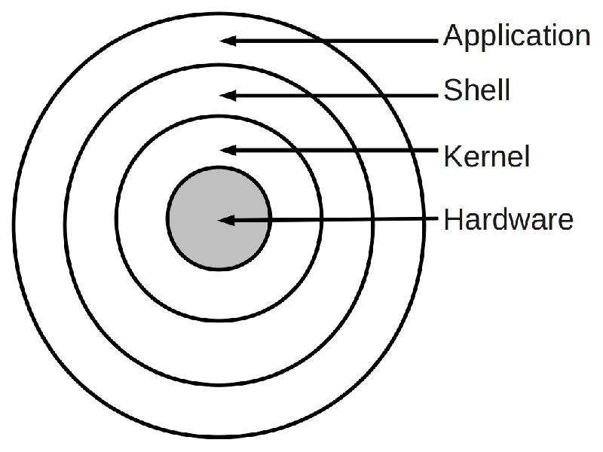
What is Shell ?
The “Shell” is simply another program on top of the kernel which provides a basic human-OS interface.
It is a command interpreter
Enables users to run services provided by the UNIX OS
Functionality:
Command Interpreter
Interface
Programming language
21/02/19
Operating system
47
Notes:
47
MIT-WPU

Slide 48
The Shell
The UNIX user interface is called the shell.
The shell does 4 jobs repeatedly:
display
prompt
read
command
execute
command
the shell
process
command

Slide 49
Most Commonly Used Shells
/bin/csh -- C shell
/bin/tcsh -- Enhanced C Shell
/bin/sh -- The Bourne Shell / POSIX shell
/bin/ksh -- Korn shell
/bin/bash -- Korn shell clone, from GNU
All Linux versions use the Bash shell (Bourne Again Shell) as the default shell
To find all available shells in your system type following command
$ cat /etc/shells
( $ means terminal prompt )
To Check default Shell of your system
$ echo $SHELL
(SHELL is a pre-defined variable)
21/02/19
Operating system
49
Notes:
49
MIT-WPU

Slide 50
What is Shell Script ?
A shell script is a series of command(s) stored in plain text file.
Why to Write Shell Script ?
Shell script can take input from user or file and output them on screen.
Useful to create our own commands. Save lots of time.
To automate some task of daily life.
System Administration part can be also automated.
21/02/19
Operating system
50
Notes:
50
MIT-WPU

Slide 51
Practical examples where shell scripting actively used:
Monitoring your Linux system.
Data backup.
Find out what processes are eating up your system resources.
Find out available and free memory.
Find out all logged in users and what they are doing.
Find out if all necessary network services are running or not.
And many more…..
21/02/19
Operating system
51
Notes:
51
MIT-WPU

Slide 52
Create a script
Use gedit as text editors for shell scripting
Example:
$ gedit hello
and type the following inside it:
#!/bin/bash
echo “Hello World”
The first line tells Linux to use the bash interpreter to run this script as hello.sh.
bash comments start with a hash mark (#)
To prepare the file for running, just turn on its execute bit
Syntax to setup executable permission:
$ chmod +x your-script-name.
$ chmod 755 your-script-name.
21/02/19
Operating system
52
Notes:
52
MIT-WPU

Slide 53
Run a script (execute a script)
Different ways to run the script :
bash your-script-name
sh your-script-name
./your-script-na
Example :
$ bash hello
$ sh hello
$ ./hello
Example (hello script)
#!/bin/bash
echo “Hello, world!”
Output:
$ chmod +x hello
$ ./hello
Hello, world!
21/02/19
Operating system
53
Notes:
53
MIT-WPU

Slide 54
Variables in Shell
Variables are global within a script
Types of variable:
System variables - Created and maintained by Linux itself. This type of variable defined in CAPITAL LETTERS.
User defined variables (UDV) – Created and maintained by user. This type of variable defined in lower letters. To define UDV use following syntax:
variable name=value
Examples: (You must use $ followed by variable name when using value.)
mylang="Pennsylvania Dutch"
echo "I speak $mylang."
I speak Pennsylvania Dutch.
echo 'I speak $mylang.'
I speak $mylang.
vech=Bus
n=10
echo $vech
echo $n
21/02/19
Operating system
54
Notes:
54
MIT-WPU

Slide 55
Input / Output
Use the read command to prompt for input from user
Syntax:
read var_name
Use of echo and printf command to
Syntax:
echo “Message” OR echo $ var_name
Example :
$ echo "Your first name please:"
$ read fname
$ echo "Hello $fname, Lets be friend!“
21/02/19
Operating system
55
Notes:
55
MIT-WPU

Slide 56
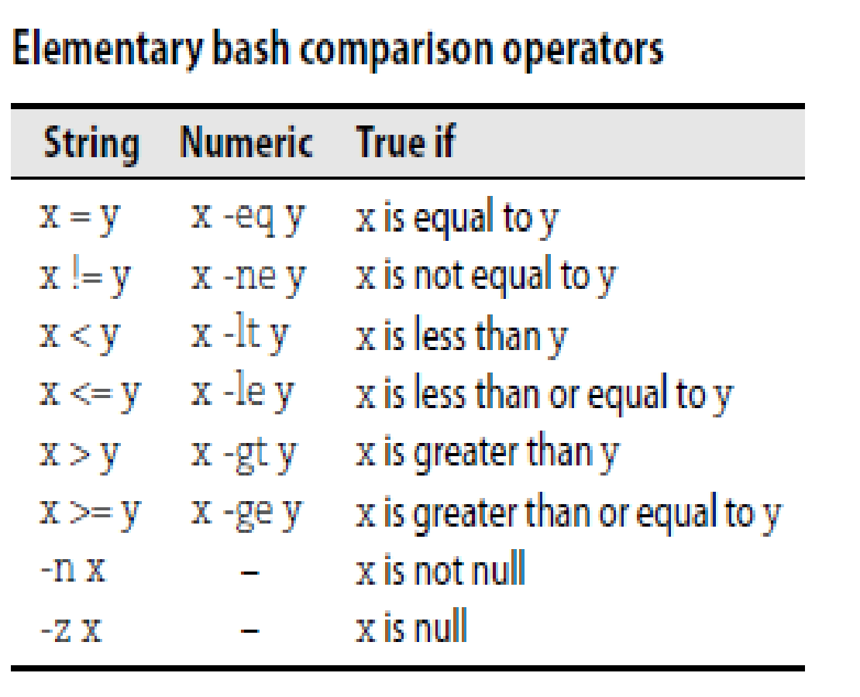
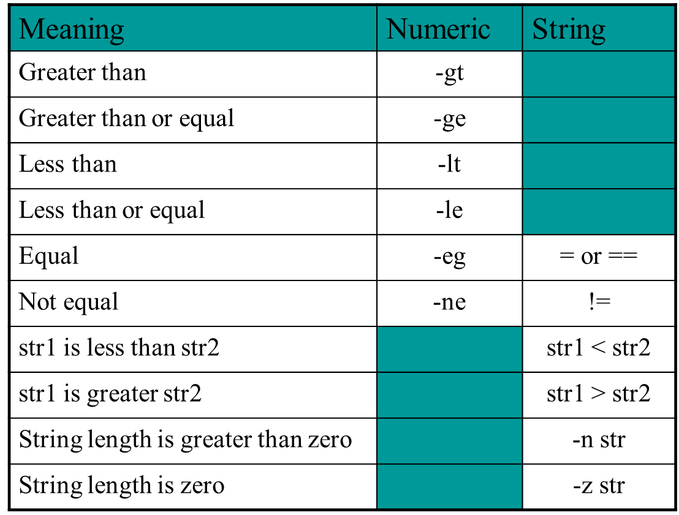
Bash Comparison Operator
21/02/19
Operating system
56
Notes:
56
MIT-WPU

Slide 57
Conditional Control Statement: if
Syntax: if….fi
if condition
then
command1 #if condition is true
Fi
Syntax: if…else...fi
if condition
then
command1 # if condition is true
else
Command2 # if condition is flase
fi
Example:
$ gedit myscript.sh
read choice
if [ $choice -gt 0 ]
then
echo "$choice number is positive"
else
echo "$choice number is negative"
fi
21/02/19
Operating system
57
Notes:
57
MIT-WPU

Slide 58
Loops in Shell Scripts
for Loop
Syntax:
for { variable name } in { list }
do
#execute one for each item in the list until the list is not finished and repeat all statement between do and done
done
while loop
Syntax :
while [ condition ] #space required
do
command1 command2 command3 .. ....
done
Example :
i=1; n=1
while [ $i -le 10 ]
do
echo "$n * $i =" `expr $i \* $n` i=`expr $i + 1`
done
Example :
for i in 1 2 3 4 5
do
echo "Welcome $i times"
done
21/02/19
Operating system
58
Notes:
58
MIT-WPU

Slide 59
case Statement in Shell Scripts
Syntax:
case $variable-name in
pattern1) command…..;;
pattern2) command…..;;
pattern N) command….;;
.
*) command ;; #default case
esac
Example :
read var
case $var in
1) echo “One”;;
2) echo “Two”;;
3) echo “Three”;;
4) echo “Four”;;
*) echo "Sorry, it is bigger than Four";;
esac
21/02/19
Operating system
59
Notes:
59
MIT-WPU

Slide 60
Functions in Shell Scripts
Function is series of instruction/commands.
Function performs particular activity in
shell.
Syntax:
function-name ( )
{
Function body
}
Example :
today()
{
echo “Today is `date`”
return
}
today
21/02/19
Operating system
60
Notes:
60
MIT-WPU

Slide 61
Special Files
/home - all users’ home directories are stored here
/bin, /usr/bin - system commands
/sbin, /usr/sbin - commands used by sysadmins
/etc - all sorts of configuration files
/var - logs, spool directories etc.
/dev - device files
/proc - special system files

